Slide 1
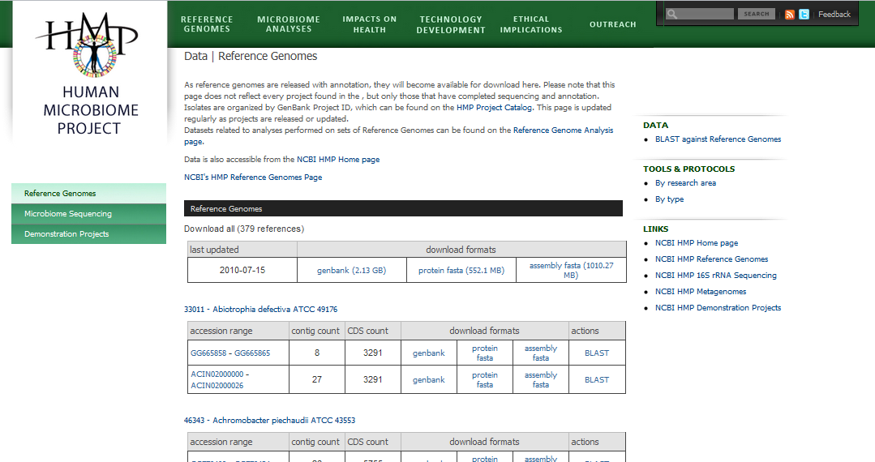
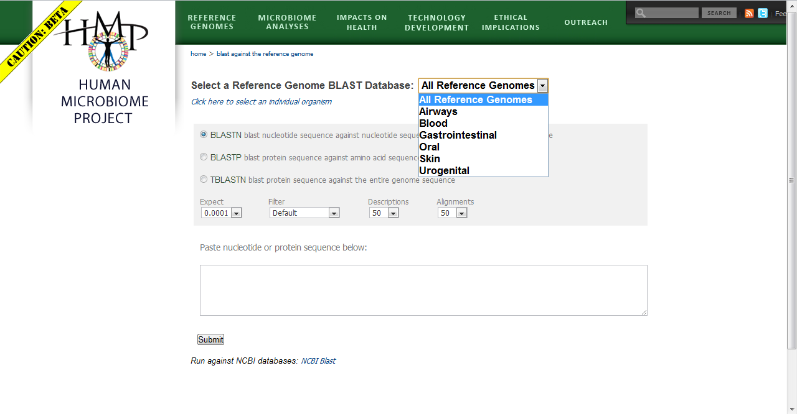
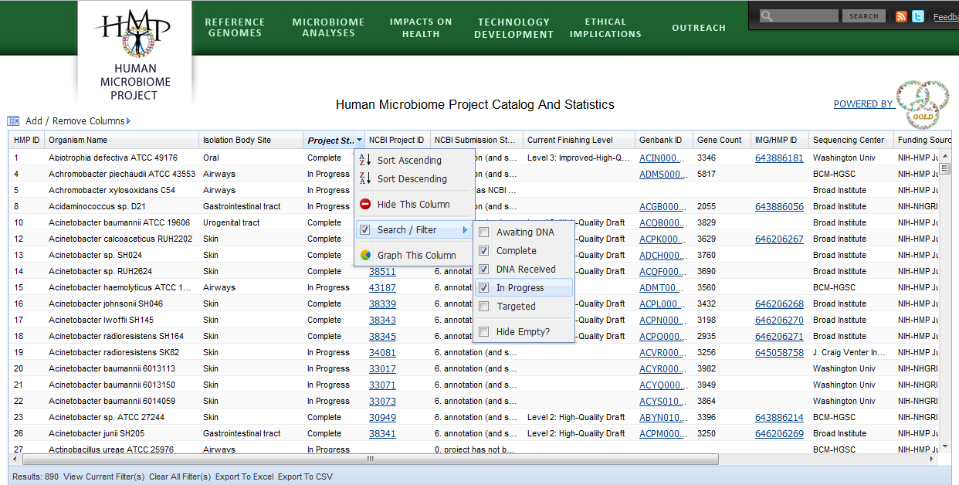
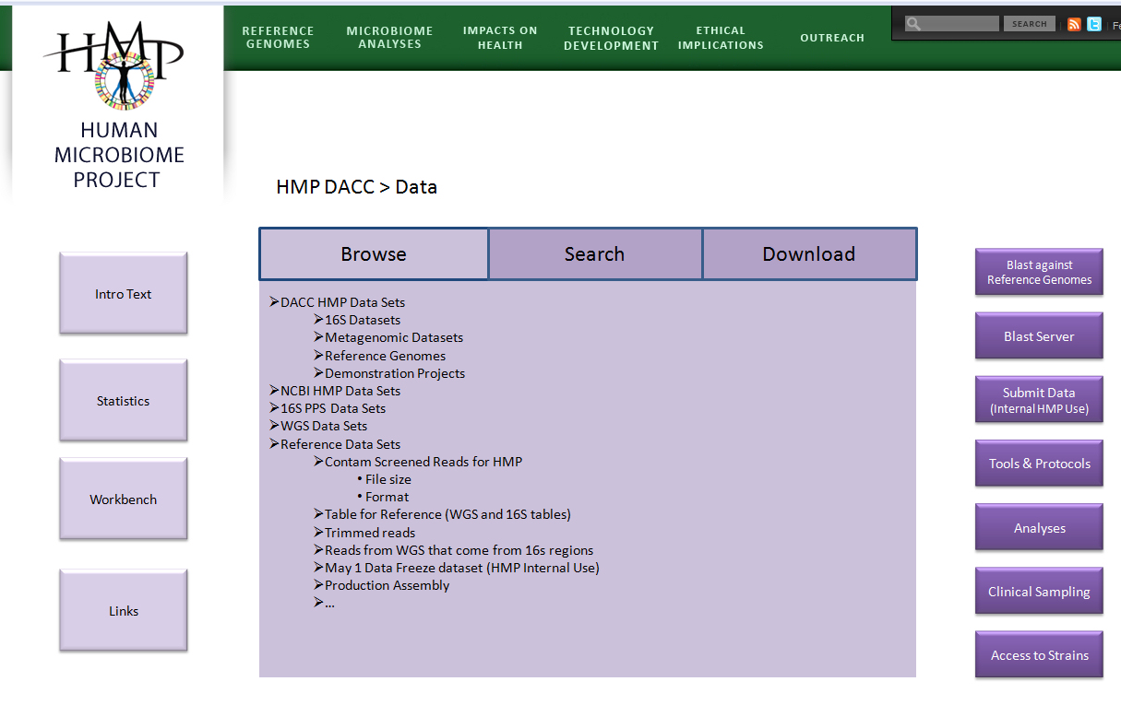
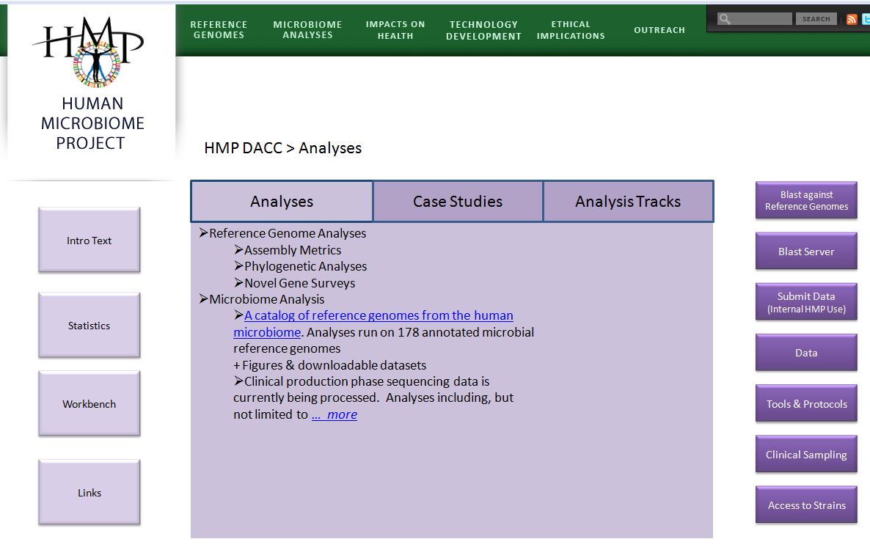
THE DATA ANALYSIS & COORDINATION (DACC) WEB PORTAL
www.hmpdacc.org
Heather Creasy¹, Catherine Jordan¹, Mark Mazaitis¹, Noam Davidovicz¹, Michelle Giglio¹, Joshua Orvis¹, Ken Chu², Konstantinos Liolios³, Amy Chen², Victor Felix¹, Nikos Kyrpides³, Victor Markowitz², Anup Mahurkar¹, Jennifer Wortman¹, Owen White¹
¹Institute for Genome Sciences, University of Maryland School of Medicine, Baltimore, MD; ²Lawrence Berkeley National Laboratory, Berkeley, CA; ³Joint Genome Institute, Walnut Creek, CA
Data Organization & Display
Tools Organization & Display
We currently offer a BLAST server for searching against all or subsets of annotated Reference Genomes. Over time, we will expand this to include additional datasets
Introduction
The HMP Data Analysis and Coordination Center (DACC) plays the role of collecting, integrating & standardizing different data types from diverse sources and presenting this data back to the community in a clear & useful manner via our web resource at www.hmpdacc.org. The DACC website is constantly evolving with regard to data presentation and functionality. The long term value of the HMP DACC website is in facilitating access to data and tools, making it easy for the user to (1) download HMP data, (2) combine data with a tool, and (3) perform analyses; building a community of researchers; and providing unique and novel content to all users, both HMP consortium members & members of the larger scientific community.
In order to accomplish this, we have elected to take a three phase approach:
Phase 1: address usability issues of the site
Phase 2: address the needs of the research community by highlighting data as it becomes available and
facilitating access to data, tools, resources & protocols in use by the HMP consortium
Phase 3: enable the community to perform analyses on their own, by demonstrating and documenting pipelines
and intermediate data sets that can be used to replicate or expand existing research questions
We have completed Phase 1 and are now transitioning to Phase 2. Here we present concepts and mocks ups demonstrating our goals to continue improvements to usability, increase the level of interactivity, and add data sets, tools and protocols as they become available. Our approach emphasizes working with metagenomic users & focus groups to identify their data needs and how they expect to interact with the site. To that end, we are actively soliciting feedback via a user survey available throughout this conference.
As new tools, resources & protocols become available as part of the HMP, they will be included here. Future features will include searchability & sortability to generate customized tool sets with documentation
Users will soon see a new look to the Reference Genome Project Catalog, with improved searchability and graphing. Next, we will enable users to select strain sets of interest and link directly to the corresponding data set for download
The DACC hosts an SVN repository for use by all HMP participants, for convenient maintenance of source code & documentation
A Data-centric Home Page
Data Analysis
Browse summarized data for projects and/or data types of interest, e.g.
+ All DACC HMP Data
+ Reference Genomes
- 16S rRNA Sequence
- Production Phase I Sequence
+ By Center
+ By Body Site
+ Metagenomic wgs Sequence
+ Demonstration Projects
The Analysis page has 3 focus areas:
Analyses – download datasets & analysis results coming out of HMP publications, as well as pipelines to reproduce these analyses, where available.
Case Studies - by working with users of genomic & metagenomic data, we will identify common needs and assemble pipelines specific to those needs to allow fast access to frequently used tools & analysis sets
Analysis tracks (Phase 3) - structured, interactive guides with highly detailed documentation will walk users through common analysis pipelines relevant to specific research goals.
Integration of HMP data sets, tools, case studies and analysis tracks will result in a smooth, user friendly interface for performing complex analyses.
Query available data to compile a customized dataset of interest, e.g.
“Show all human screened Metagenomic wgs reads and 16S rRNA reads from anterior nares”
NIH Program initiatives
We will expand upon the current data browsing capabilities by providing comprehensive data organization. New features will include the ability to query to create customized data sets for download.
Taking the customized tool set concept (described above) one step further, the workbench will allow users to create their own “pipelines” by stringing together available tools, for use on datasets downloaded from the DACC website or on their own data. (While we hope to introduce this concept in Phase 2, this is largely a Phase 3 improvement)
Project Catalog
img/hmp
Tools & Protocols
FTP Data Site
NCBI HMP Home Page
Easy access to the Workbench, Tools & Protocols, and Analyses pages (described elsewhere on this poster) will facilitate additional analysis.
Site Usage
High Priority Links
Phase 2 of our approach to the DACC web redesign emphasizes working with user groups to identify their data needs and how they expect to interact with the site. Please help us by completing our online user experience survey available throughout the conference. The survey can be found at www.surveymonkey.com/s/hmpdacc_phase1 through Wednesday, September 8.
In addition, we are looking at various site usage metrics, some of which are displayed to the right, to help identify areas of improvement. By improving UI navigation and site organization, and focusing on user needs & expectations, we hope to decrease our bounce rate (a measure of visit quality) dramatically over the next year. We recognize that the majority of users currently reach our site from a referring source. However 21% of site visits arrive via search engines. Looking at the most commonly used keywords bringing users to our site is another means of identifying areas of interest to the public, allowing us to address them appropriately. Other metrics reflecting the value of the site, such as the number of inbound links, will also be assessed.
Number of site visitors by month over the past year
See Data Analysis Panel
Datasets acquired above can be downloaded for personal use or integration into workbenches (See Analysis Panel)
For HMP Collaborator Use:
Access to resources used for uploading data sets to the DACC, e.g. FTP upload, DACC LBL
Google Analytics metrics measured from July 2009 to August 2010
Project Statistics
Sampling Statistics
Sequencing Statistics
Data Submission Status
Assembly Statistics
Annotation Statistics
Total number of visits: 26,232
New visitors: 12,435
Non-US Visits: 8.113
Average time spent on site: 00:03:25
Average number of pages viewed per visit: 3.51
Bounce rate: 48.61%
Funded by NIH Common Fund

